Slide 1

Cell Basis of contraction –
Cardiac Work –
Hemodynamics
Martin Siemienski Andersen
5.7-5.9 (p. 547-577)
22-11-2024

Slide 2
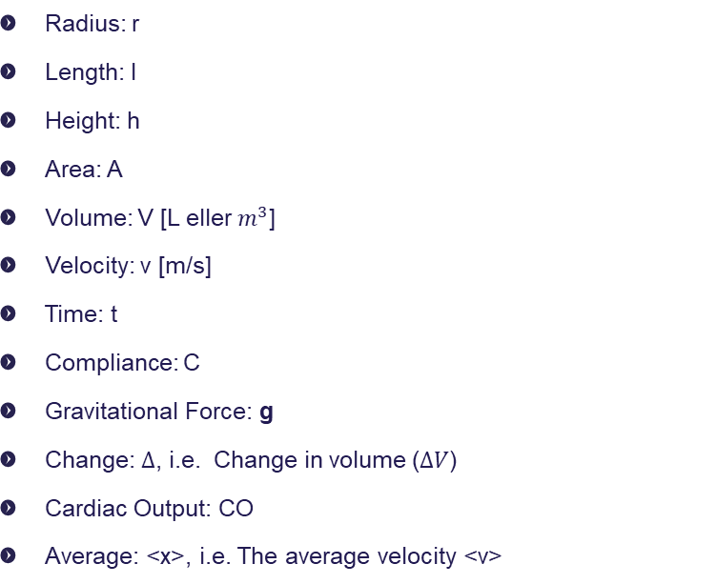
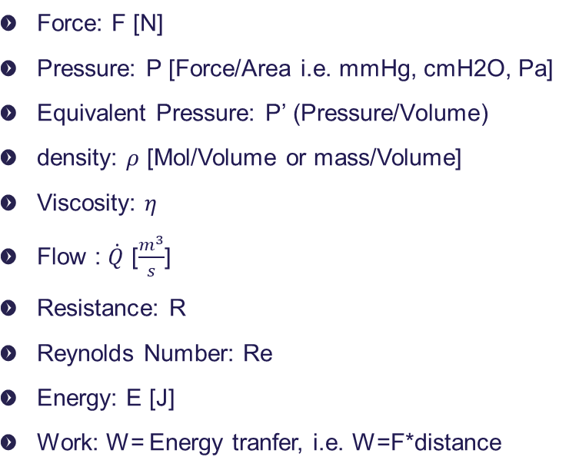
Abbreviations
Force: F [N]
Pressure: P [Force/Area i.e. mmHg, cmH2O, Pa]
Equivalent Pressure: P’ (Pressure/Volume)
density: $ρ$ [Mol/Volume or mass/Volume]
Viscosity: $η$
Flow : $\dot{Q}$ [$\frac{m^{3}}{s}$]
Resistance: R
Reynolds Number: Re
Energy: E [J]
Work: W= Energy tranfer, i.e. W=F*distance
Radius: r
Length: l
Height: h
Area: A
Volume: V [L eller $m^{3}$]
Velocity: v [m/s]
Time: t
Compliance: C
Gravitational Force: g
Change: $Δ$, i.e. Change in volume ($ΔV$)
Cardiac Output: CO
Average: <x>, i.e. The average velocity <v>

Slide 3
Agenda
Contractability
The cardiac function
Preload and afterload
Hemodynamics

Slide 4
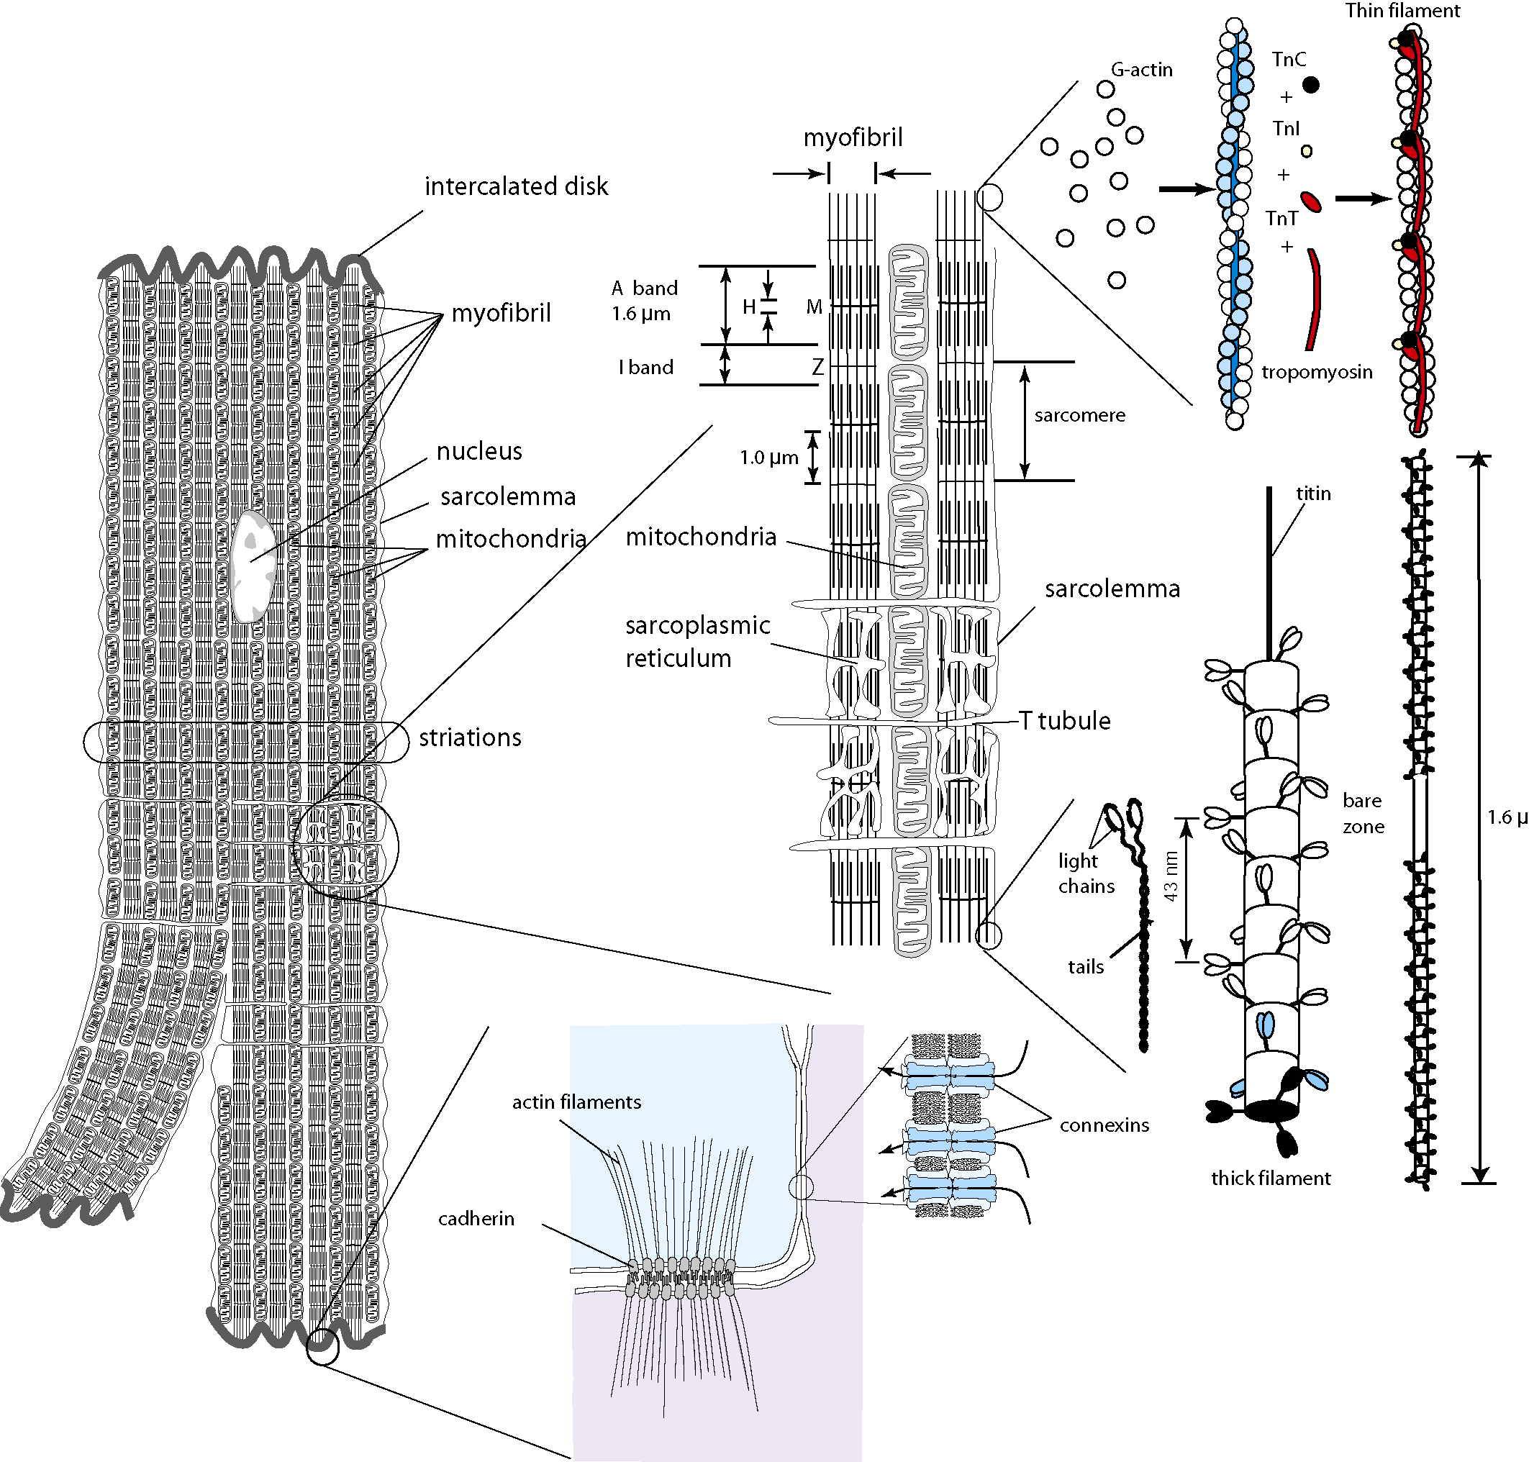

Cardiac Contractility
The cardiac cell
Cardiac cell
  Width $10μm−20 μm$
  Length $50μm−100μm$
  Stratiated due to regular arrangement of myofilaments
  Electrically coupled to other cardiomyocytes

Slide 5
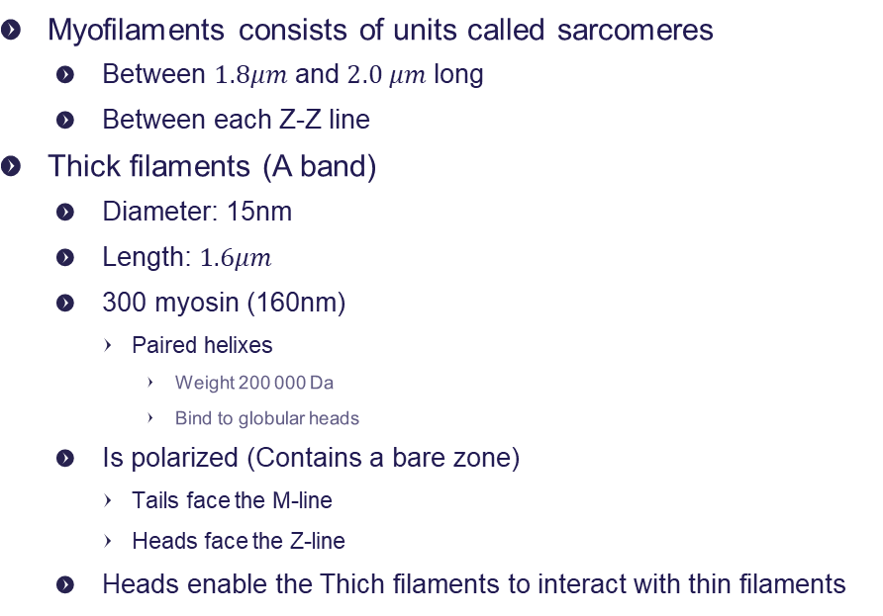
Cardiac Contractility
The cardiac cell
Dalton: Da
one-twelfth of the mass of a carbon-12 atom, about 1.660 538 86 × 10⁻²⁷ kilogram
Myofilaments consists of units called sarcomeres
  Between $1.8μm$ and $2.0 μm$ long
  Between each Z-Z line
Thick filaments (A band)
  Diameter: 15nm
  Length: $1.6μm$
  300 myosin (160nm)
    Paired helixes
      Weight 200 000 Da
      Bind to globular heads
  Is polarized (Contains a bare zone)
    Tails face the M-line
    Heads face the Z-line
  Heads enable the Thich filaments to interact with thin filaments
Notes:
Dalton: Da
one-twelfth of the mass of a carbon-12 atom, about 1.660 538 86 × 10⁻²⁷ kilogram

Slide 6
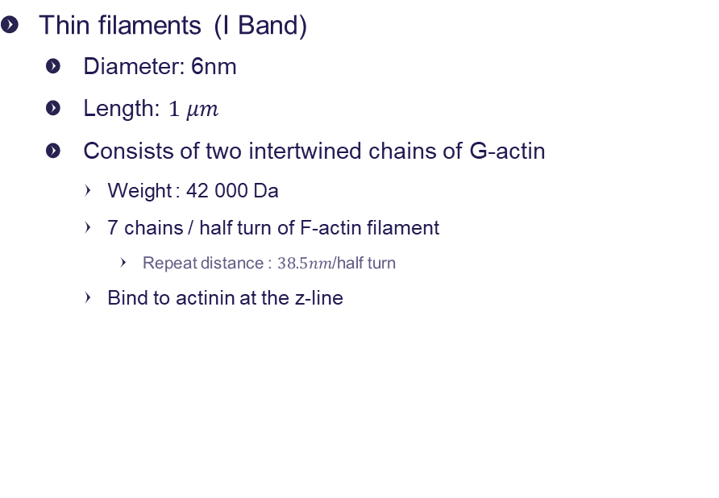
Cardiac Contractility
The cardiac cell
Dalton: Da
one-twelfth of the mass of a carbon-12 atom, about 1.660 538 86 × 10⁻²⁷ kilogram
Thin filaments (I Band)
  Diameter: 6nm
  Length: $1 μm$
  Consists of two intertwined chains of G-actin
    Weight : 42 000 Da
    7 chains / half turn of F-actin filament
      Repeat distance : $38.5nm$/half turn
    Bind to actinin at the z-line
Notes:
Dalton: Da
one-twelfth of the mass of a carbon-12 atom, about 1.660 538 86 × 10⁻²⁷ kilogram

Slide 7
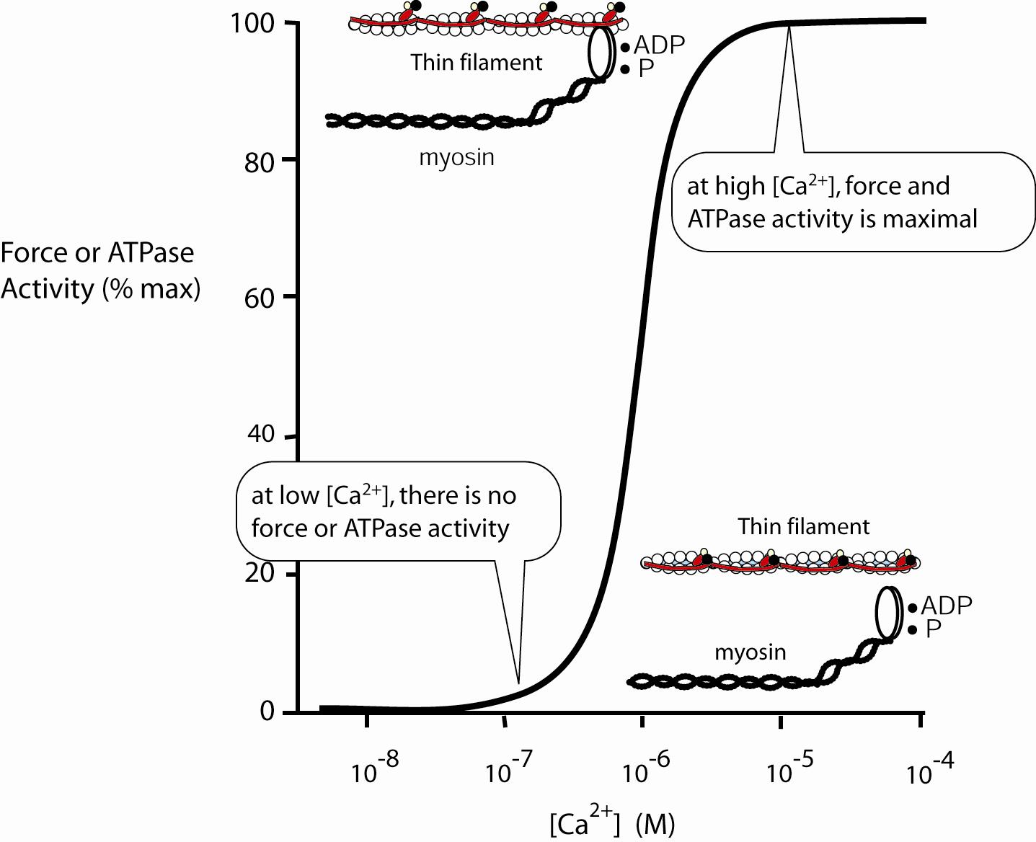
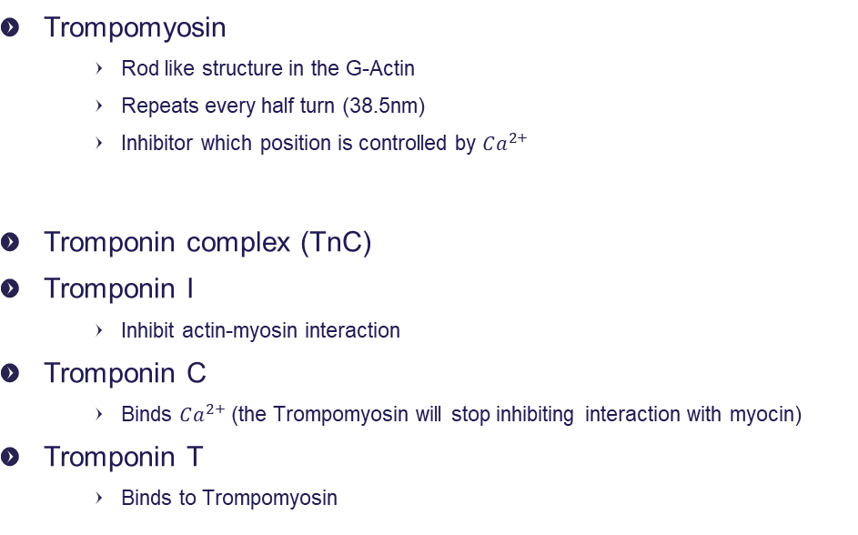
The cardiac cell
Trompomyosin is on thin filaments
Dalton: Da
one-twelfth of the mass of a carbon-12 atom, about 1.660 538 86 × 10⁻²⁷ kilogram
Trompomyosin
    Rod like structure in the G-Actin
    Repeats every half turn (38.5nm)
    Inhibitor which position is controlled by $Ca^{2+}$
Tromponin complex (TnC)
  Tromponin I
    Inhibit actin-myosin interaction
  Tromponin C
    Binds $Ca^{2+}$ (the Trompomyosin will stop inhibiting interaction with myocin)
  Tromponin T
    Binds to Trompomyosin
Notes:
Trompomyosin is on thin filaments
Dalton: Da
one-twelfth of the mass of a carbon-12 atom, about 1.660 538 86 × 10⁻²⁷ kilogram

Slide 8
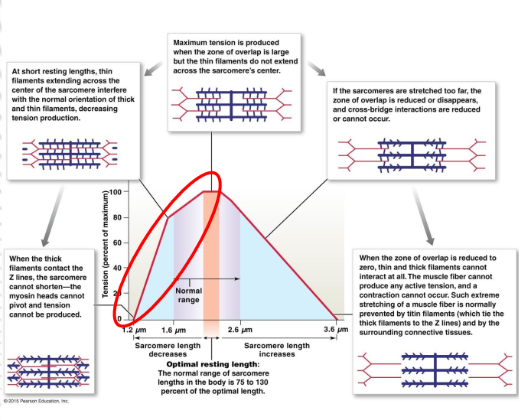
Contractile force with respect to myocyte length
2
Too large overlap of filaments → reduced tension
  Thin filaments interfere with normal orientation of thick and thin filaments
Overlap does not extend more than halfway from the sarcomere center → strongest tension
Loo little overlap → reduced tension
  Cross-bridge interactions are reduced
1
3

Slide 9
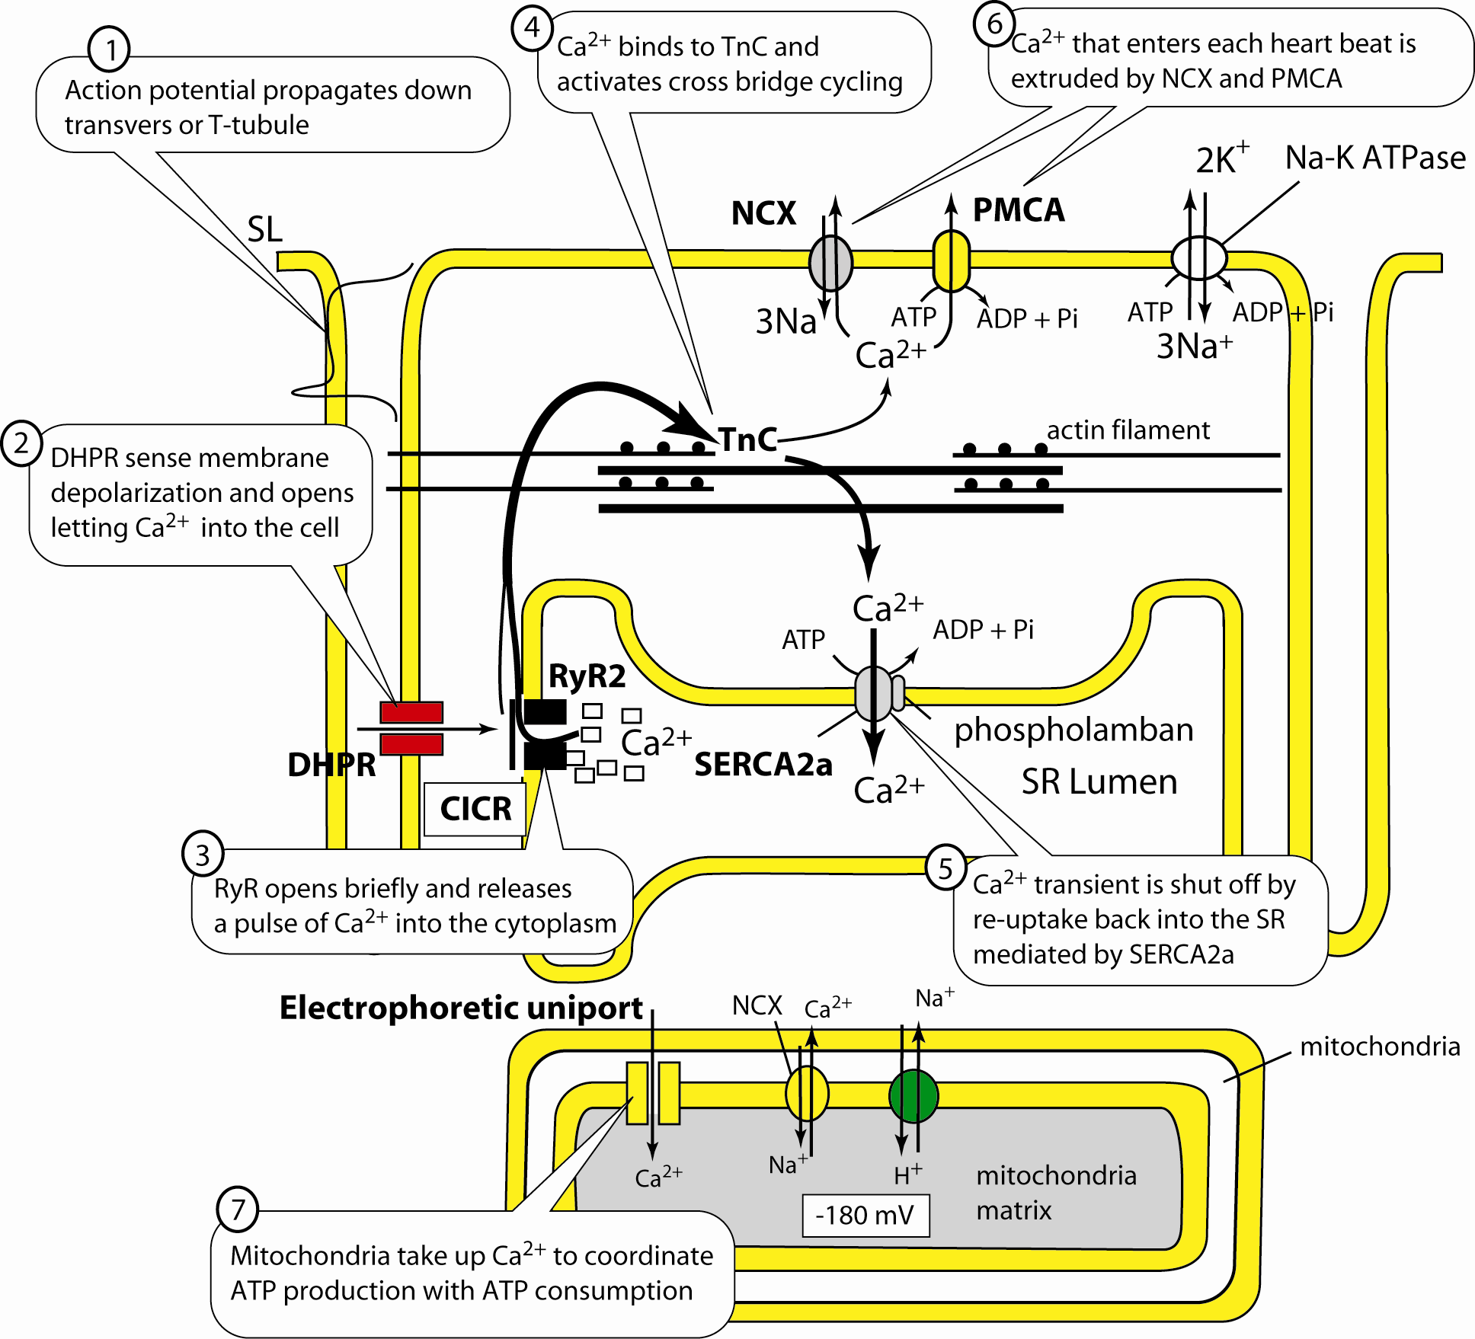
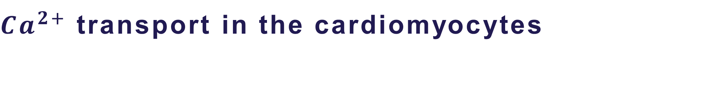
$Ca^{2+}$ transport in the cardiomyocytes
RyR: Ryanodine Receptor
DHPR: The Dihydropyridine Receptor (DHPR)
CICR: Calium induced calium release
TnC: Tromponin complex
SR: Sarcoplasmic Reticulum

Slide 10

What regulates cardiac contractility?
Changes in the size of [$Ca^{2+}]$ transient
Change the sensitivity of the myofilaments to given [$Ca^{2+}$] transient

Slide 11
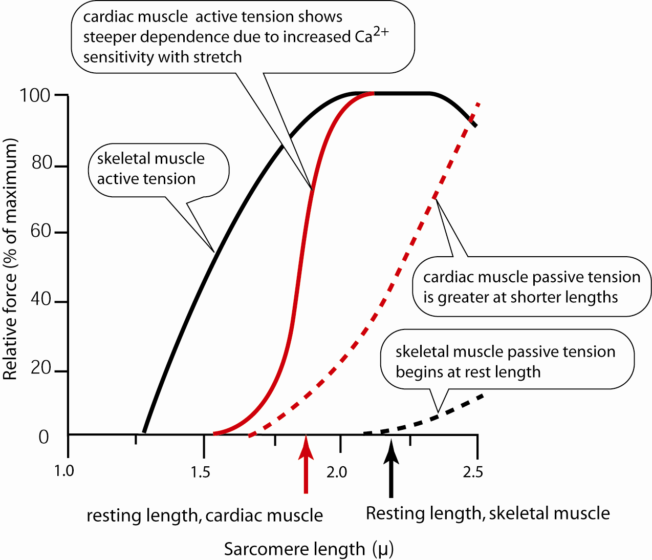
Cardiac Contraction Strength
Notes:
Når HR øjes vil der initialt være et svagere force
(Grund på næste slide)

Slide 12
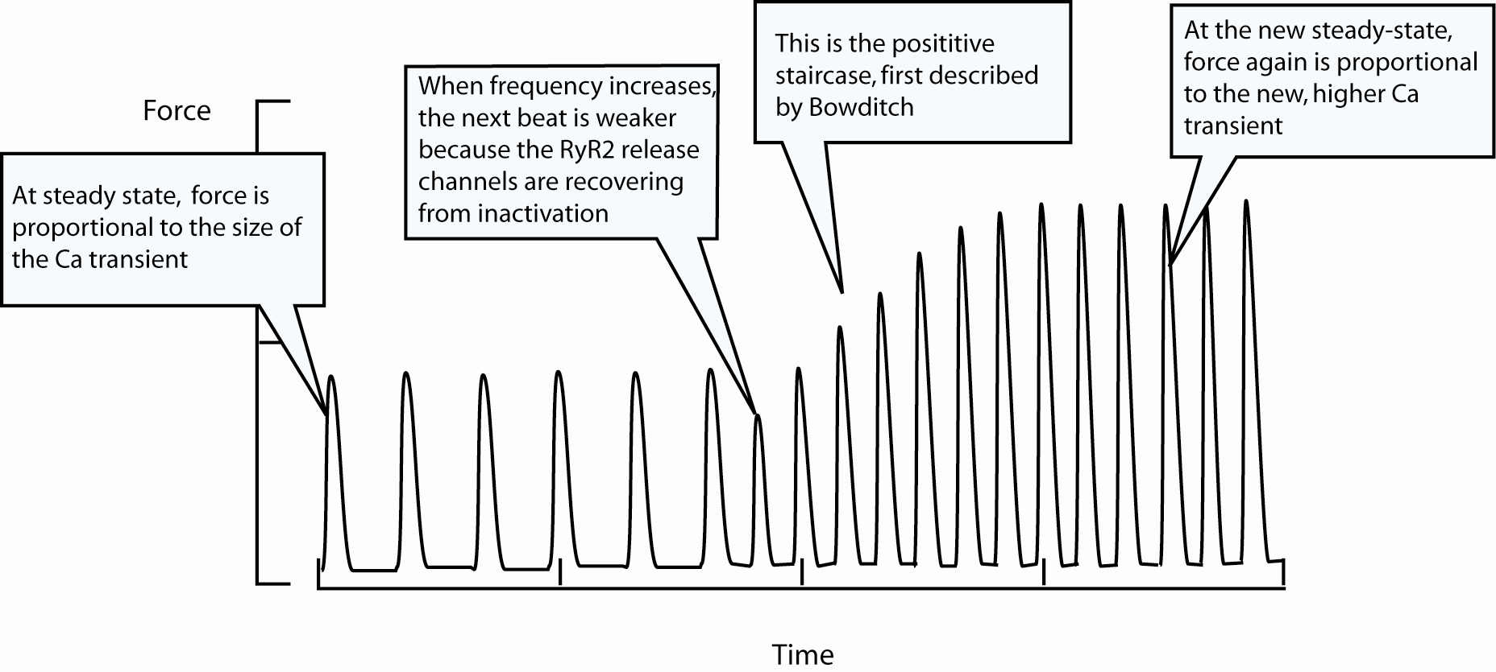
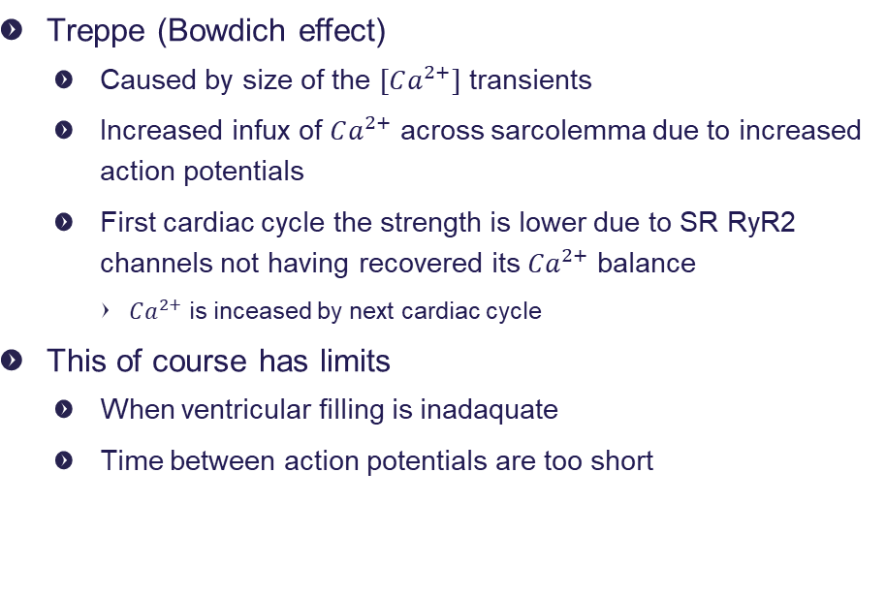
Cardiac Contractility
Treppe (Bowdich effect)
  Caused by size of the $[Ca^{2+}]$ transients
  Increased infux of $Ca^{2+}$ across sarcolemma due to increased action potentials
  First cardiac cycle the strength is lower due to SR RyR2 channels not having recovered its $Ca^{2+}$ balance
    $Ca^{2+}$ is inceased by next cardiac cycle
This of course has limits
  When ventricular filling is inadaquate
  Time between action potentials are too short
Notes:
size of the $[Ca^{2+}]$ transients : mængden der forbliver i cellen

Slide 13
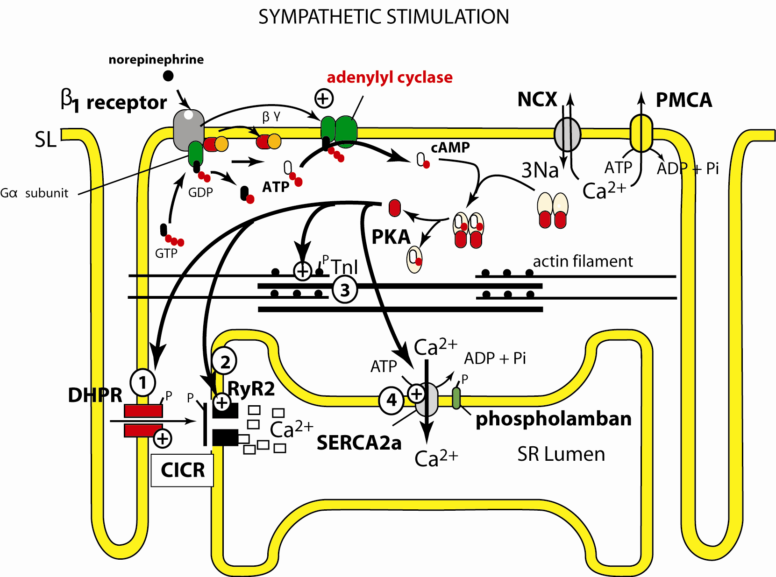
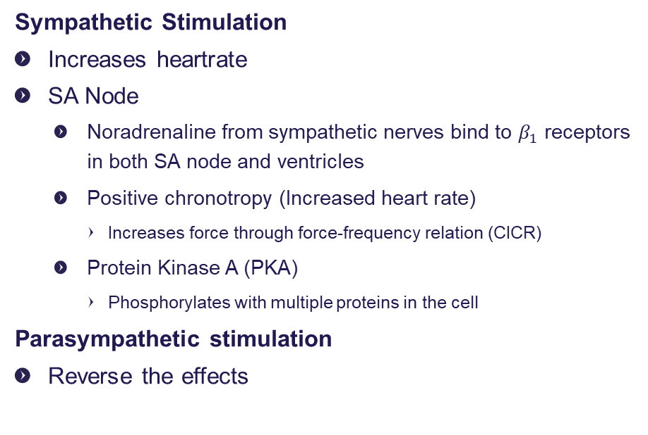
Heart Rate Regulation
Sympathetic Stimulation
Increases heartrate
SA Node
  Noradrenaline from sympathetic nerves bind to $β_{1}$ receptors in both SA node and ventricles
  Positive chronotropy (Increased heart rate)
    Increases force through force-frequency relation (CICR)
  Protein Kinase A (PKA)
    Phosphorylates with multiple proteins in the cell
Parasympathetic stimulation
Reverse the effects
Notes:
CICR : Calcium-induced calcium release
Phosphorylates: add phosphate group to organic molecule
PKA is also commonly known as cAMP-dependent protein kinase, because it has traditionally been thought to be activated through release of the catalytic subunits when levels of the second messenger called cyclic adenosine monophosphate, or cAMP, rise in response to a variety of signals
Kinase: Any of various enzymes that catalyze the transfer of a phosphate group from a donor, such as ADP or ATP, to an acceptor.

Slide 14
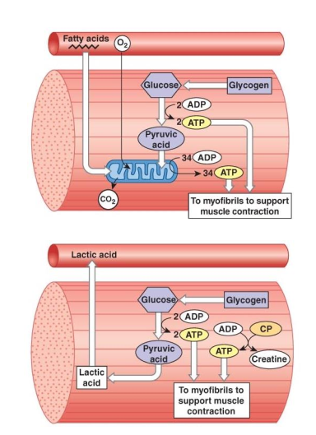
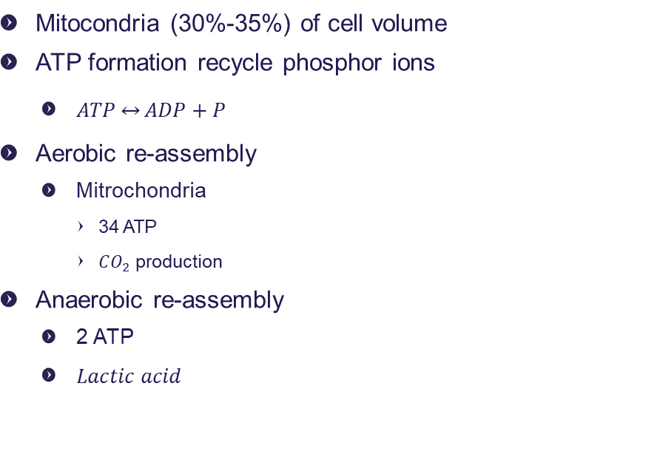
ATP production
Mitocondria (30%-35%) of cell volume
ATP formation recycle phosphor ions
  $ATP\underset{↔}{}ADP+P$
Aerobic re-assembly
  Mitrochondria
    34 ATP
    $CO_{2}$ production
Anaerobic re-assembly
  2 ATP
  $Lactic acid$
Notes:
Adenosine Triphosphate Bihosphate

Slide 15
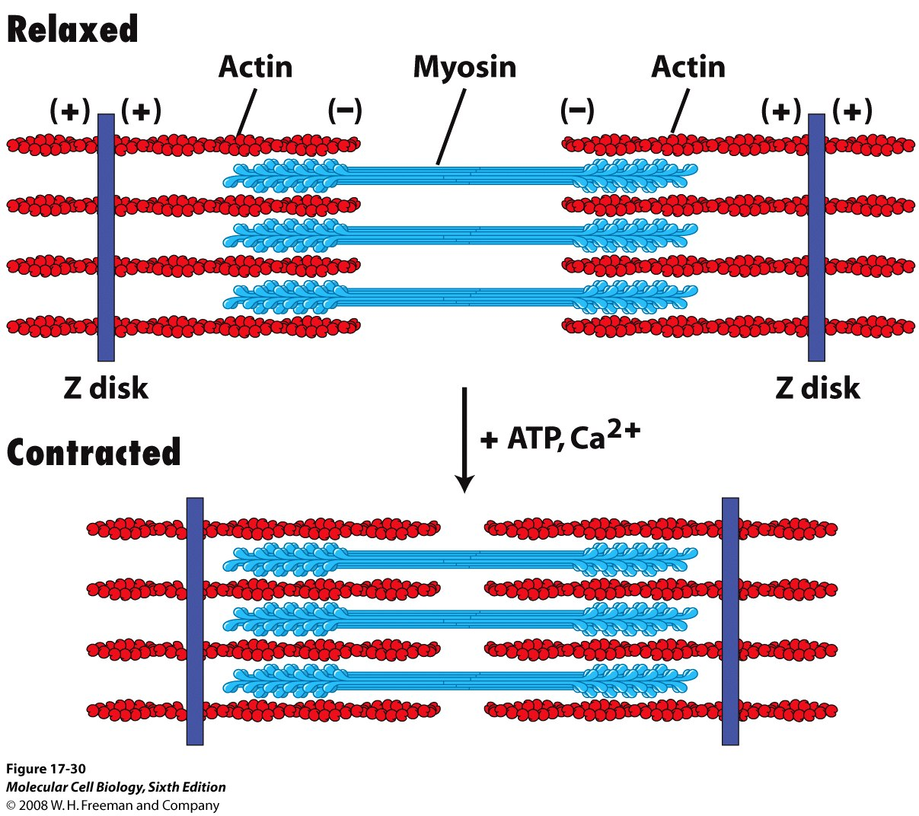

Slide 16
Agenda
Contractability
The cardiac function
Preload and afterload
Hemodynamics

Slide 17
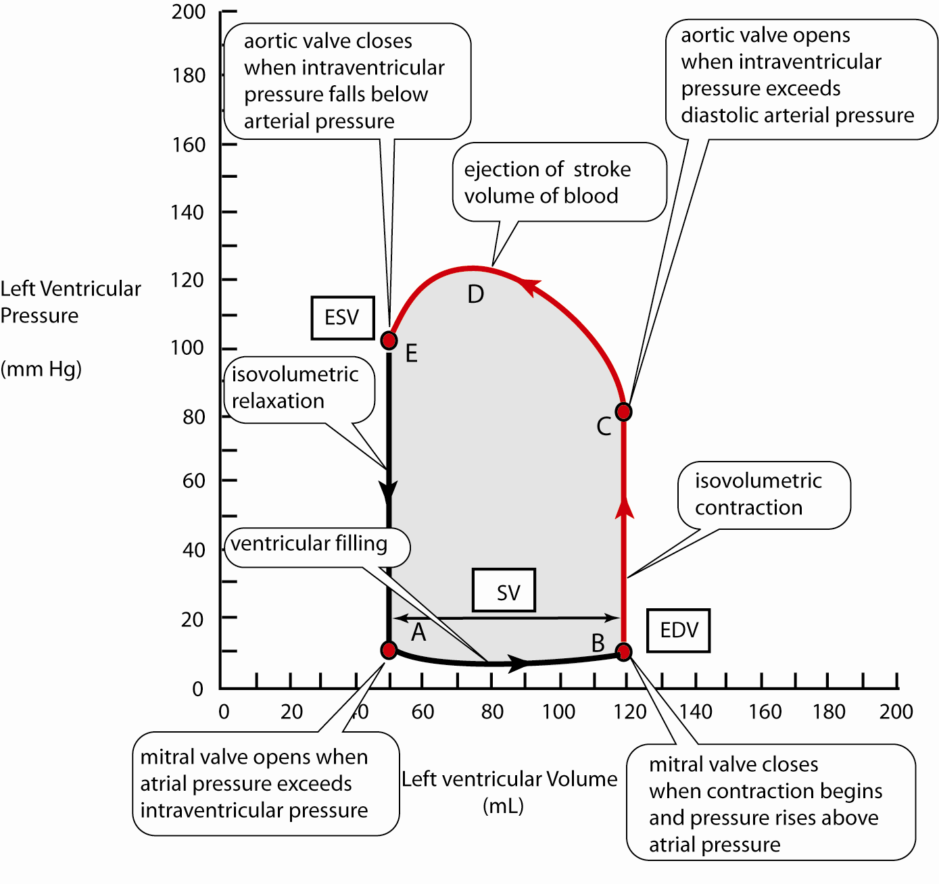
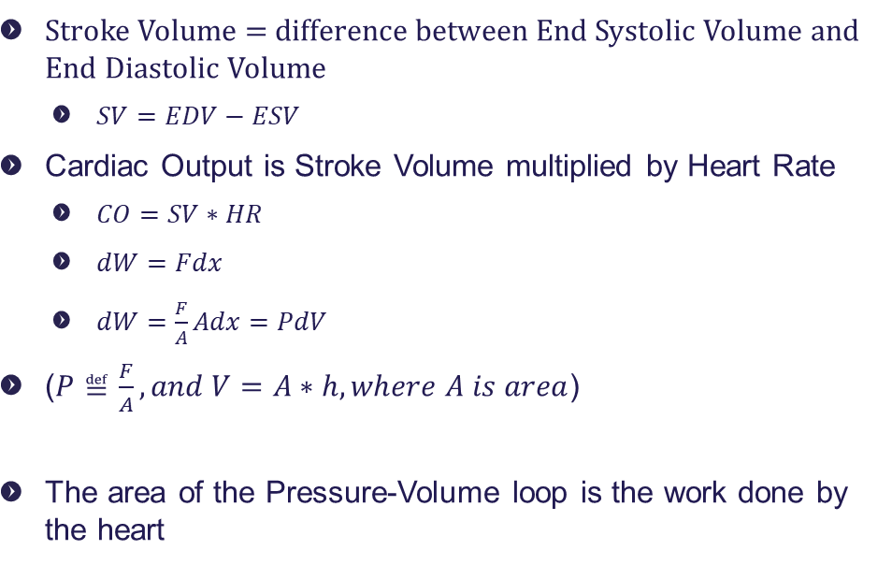
Cardiac function curve
Stroke Volume = difference between End Systolic Volume and End Diastolic Volume
  $SV=EDV−ESV$
Cardiac Output is Stroke Volume multiplied by Heart Rate
  $CO=SV∗HR$
  $dW=Fdx$
  $dW=\frac{F}{A}Adx=PdV$
($P≝\frac{F}{A}, and V=A∗h, where A is area$)
The area of the Pressure-Volume loop is the work done by the heart

Slide 18
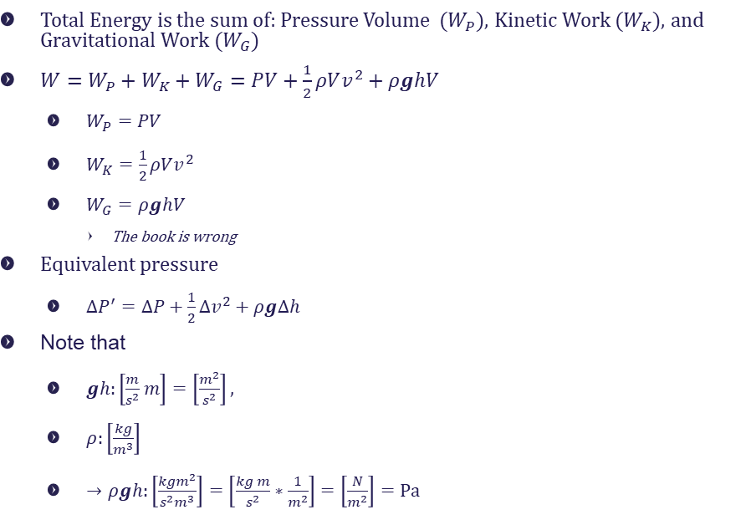
Cardiac function curve
Total Energy is the sum of: Pressure Volume ($W_{P}$), Kinetic Work ($W_{K}$), and Gravitational Work ($W_{G}$)
$W=W_{P}+W_{K}+W_{G}=PV+\frac{1}{2}ρVv^{2}+ρghV$
  $W_{P}=PV$
  $W_{K}=\frac{1}{2}ρVv^{2}$
  $W_{G}=ρghV$
    The book is wrong
Equivalent pressure
  ${ΔP}^{′}=ΔP+\frac{1}{2}{Δv}^{2}+ρgΔh$
Note that
  $gh:\left[\frac{m}{s^{2}}m\right]=\left[\frac{m^{2}}{s^{2}}\right],$
  $ρ:\left[\frac{kg}{m^{3}}\right]$
  $→ρgh:\left[\frac{kgm^{2}}{s^{2}m^{3}}\right]=\left[\frac{kg m}{s^{2}}∗\frac{1}{m^{2}}\right]=\left[\frac{N}{m^{2}}\right]=Pa$
Notes:
The area of the Pressure-Volume loop is the work done by the heart
W: joule :[kg*m^2 /s^2]

Slide 19
Agenda
Contractability
The cardiac function
Preload and afterload
hemodynamics

Slide 20
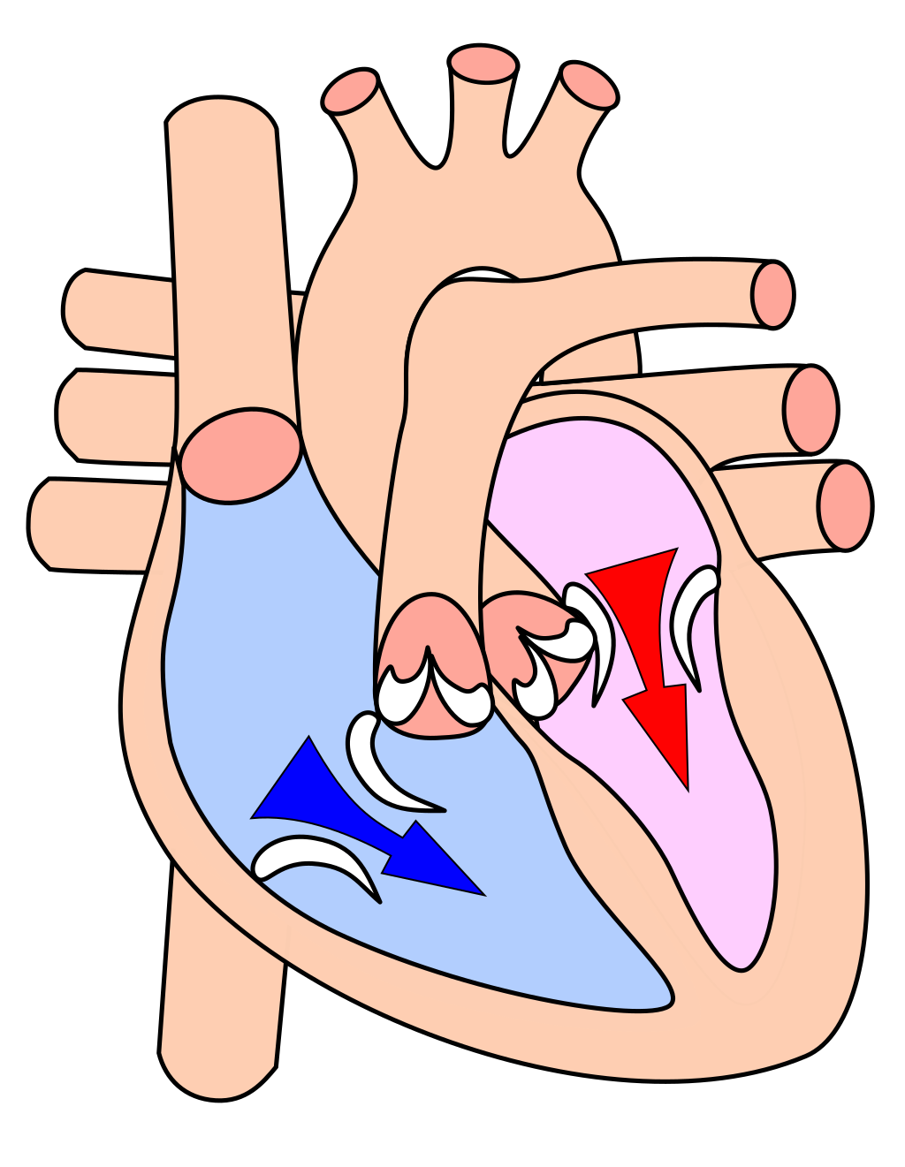
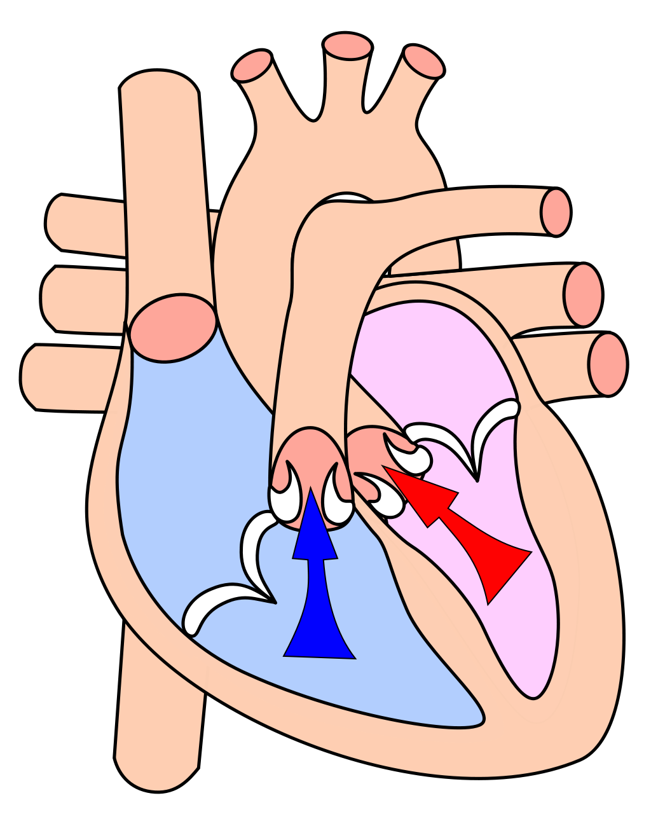
Preload vs Afterload
preload is the amount of sacromere stretch experienced by cardiomyocytes, at the end of ventricular filling during diastole.
This is proportional to the average vena cava pressure
Afterload is the pressure that the heart must work against to eject blood during systole (ventricular contraction).
Afterload is proportional to the average arterial pressure

Slide 21
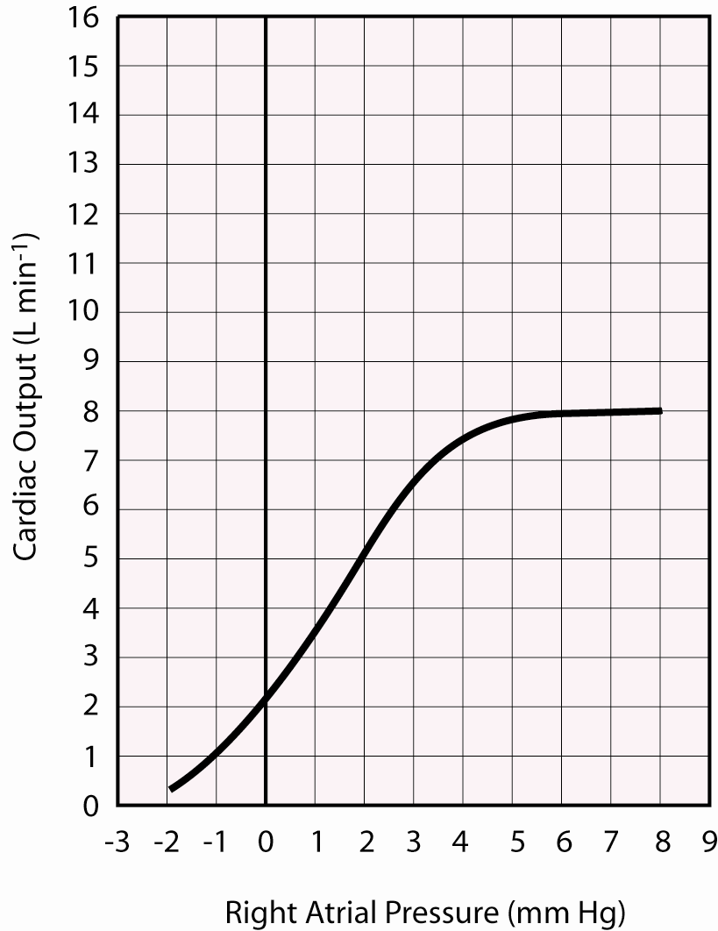
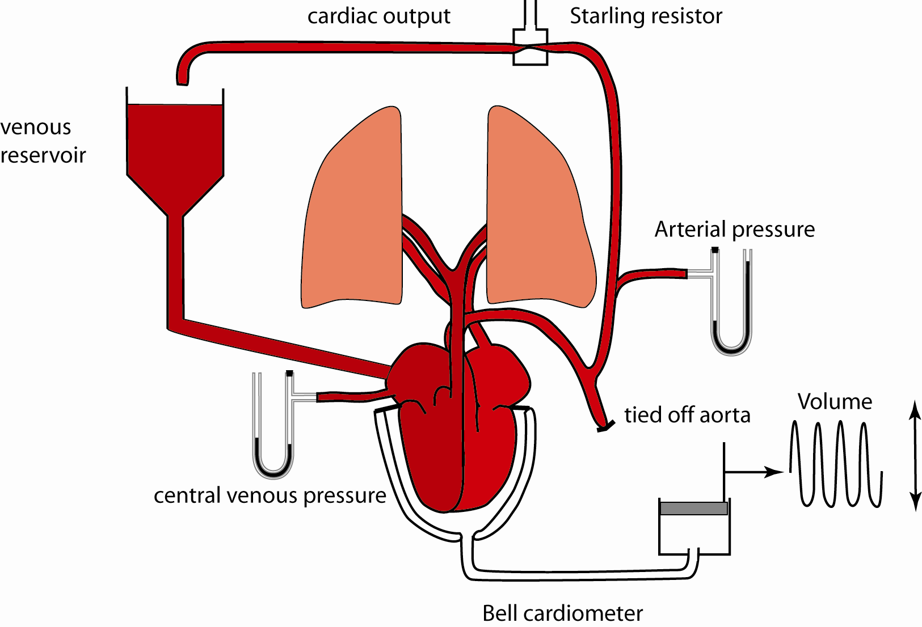
Cardiac function curve
Preload
Frank-Starling Law of the heart
Increased Venous pressure
→ Increased ventricular stretch
→ Increased Pulmonary pressure
→ Increased Ventricular Pressure
→ Increased Ventricular Stretch
→ Increased Stroke Volume

Slide 22
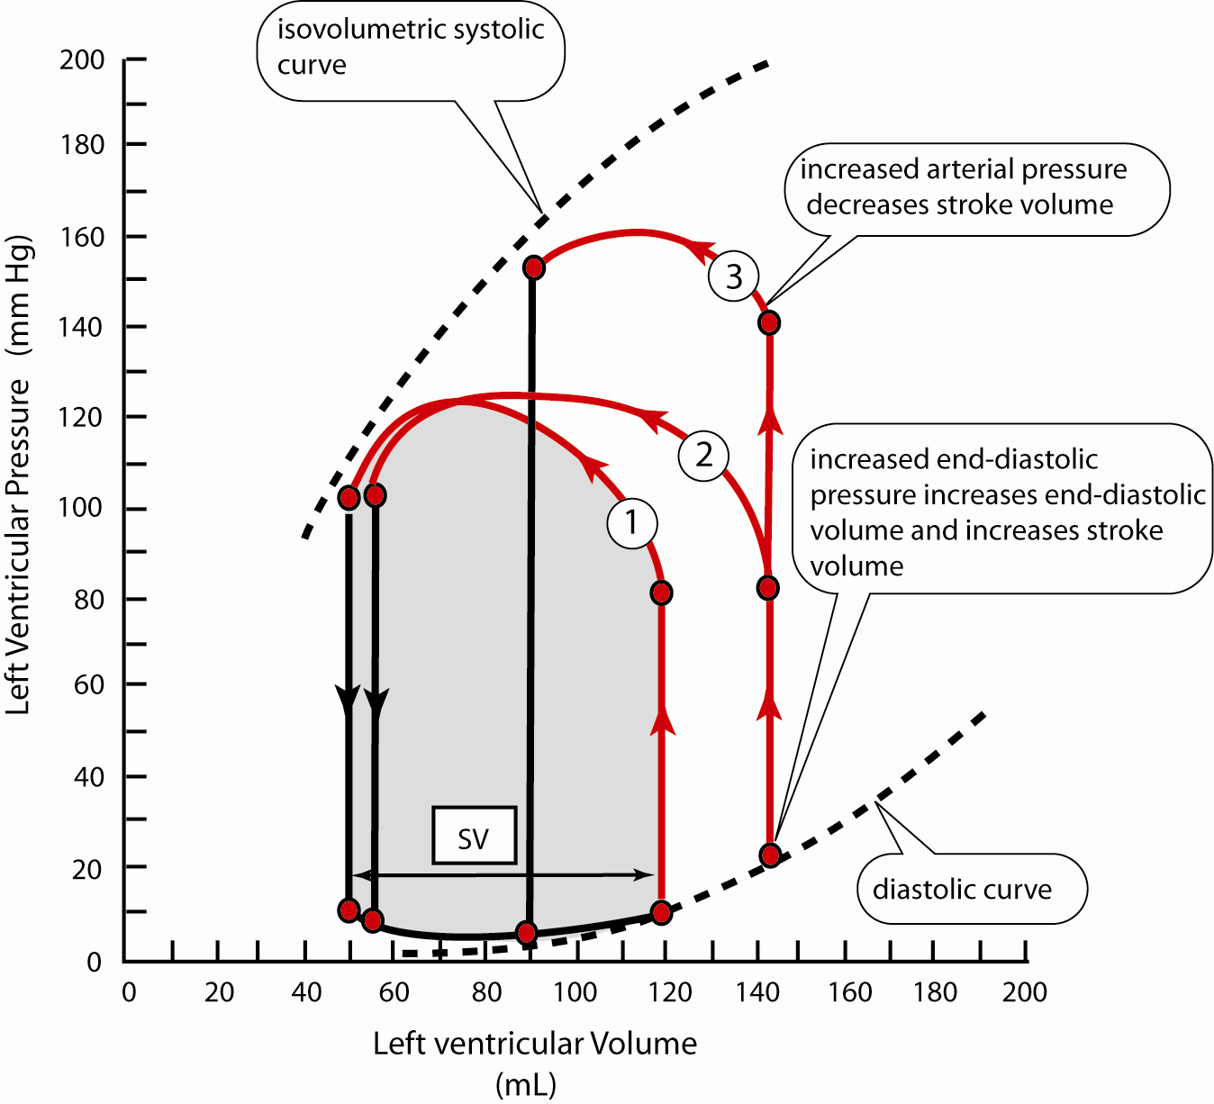
Cardiac function curve
Afterload
Arterial pressure into which stroke volume is ejected into
Increased afterload
→Reduced SV (And CO)
Notes:
The area of the Pressure-Volume loop is the work done by the heart

Slide 23
Cardiac function curve
1: Baseline
2: Increased Preload
3: Increased preload and afterload
Notes:
The area of the Pressure-Volume loop is the work done by the heart
Altså, hvis man øjer Preload, vil hjertet arbejde mere for at pumpe mere blod ud

Slide 24
What is the overall effect of Cardiac Work when increasing preload?
1: Baseline
2: Increased Preload
3: Increased preload and afterload
The heart works harder
Notes:
The area of the Pressure-Volume loop is the work done by the heart
Altså, hvis man øjer Preload, vil hjertet arbejde mere for at pumpe mere blod ud

Slide 25
Cardiac Contraction Strength
Notes:
Når HR øjes vil der initialt være et svagere force
(Grund på næste slide)

Slide 26
Agenda
Contractability
The cardiac function
Preload and afterload
Hemodynamics

Slide 27
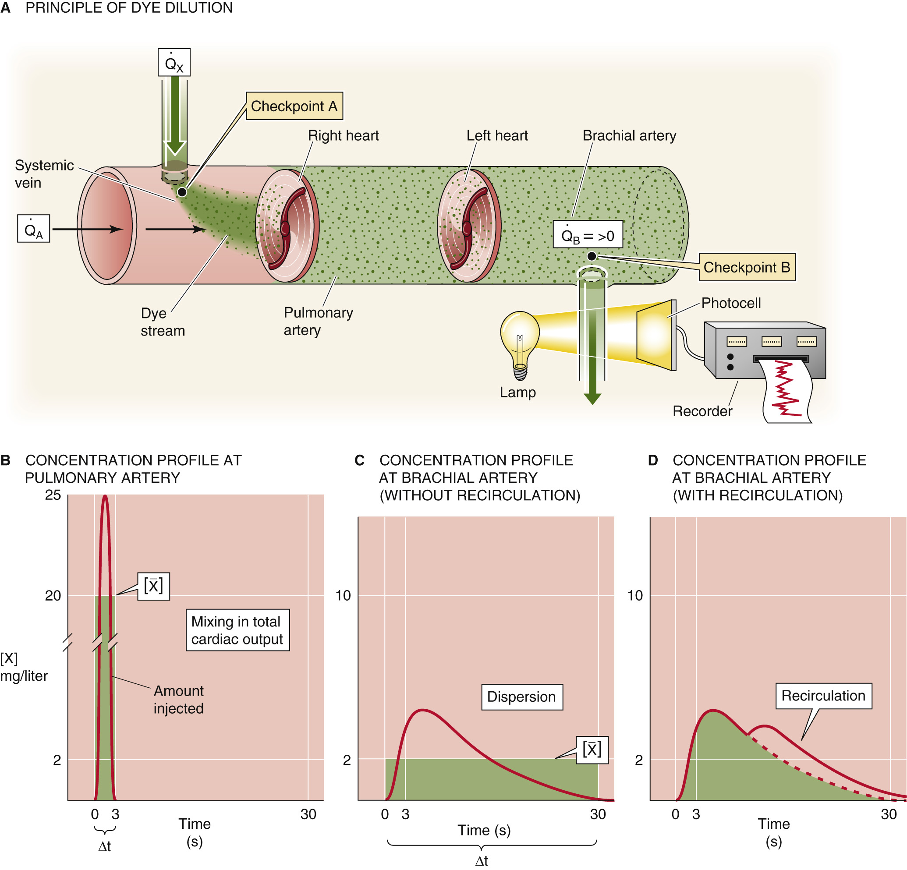

Measuring Cardiac Output
HISTORY TIME !
$\dot{Q}=\frac{m}{\int_{0}^{t}{C_{m}(n)dt}}=\frac{m}{\overline{C_{m}}∗Δt}$
  $\overline{C_{m}}$: Average concentration
  $n=HR∗dt$
Notes:
Cardiac output = indicator dose / area under the concentration time curve
Recirkulering sker fra fx coronar arterierne
M: mass in mg
C in mg/L

Slide 28
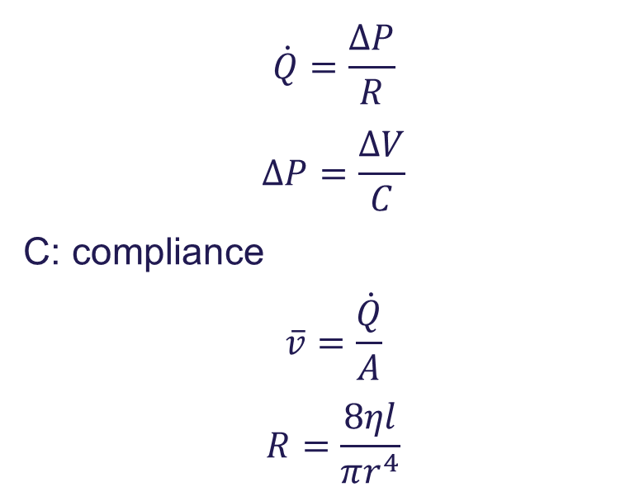

Hemodynamics relationships
$$\dot{Q}=\frac{ΔP}{R}$$
$$ΔP=\frac{ΔV}{C}$$
C: compliance
$$\overline{v}=\frac{\dot{Q}}{A}$$
$$R=\frac{8ηl}{πr^{4}}$$
Venous/Arterial ratio
  $\frac{C_{v}}{C_{A}}≈19$ for humans

Slide 29

End Pressure vs Lateral Pressure
Total mechanical energy
  $$E=E_{P}+E_{K}+E_{G}=PV+\frac{1}{2}ρv^{2}V+ρghV$$
Equivalent Pressure
  $$P^{′}=P+\frac{1}{2}ρv^{2}+ρgh$$

Slide 30
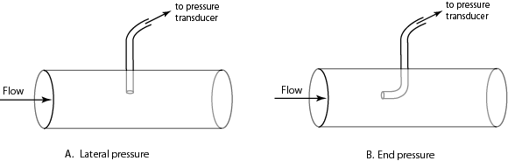

End Pressure vs Lateral Pressure
The difference between End and Lateral Pressure is the kinetic component
$$P_{End}=P_{Lat}+\frac{1}{2}ρv^{2}$$

Slide 31
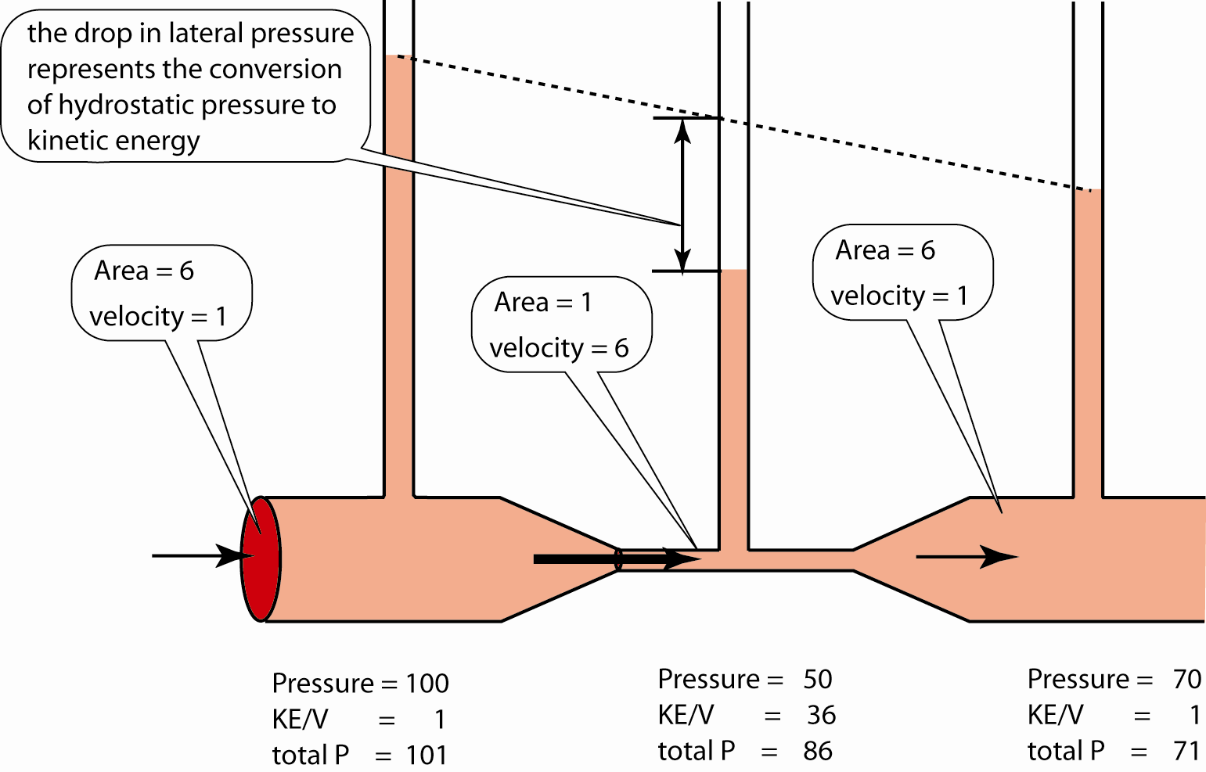
The Bernoulli Principle

Slide 32
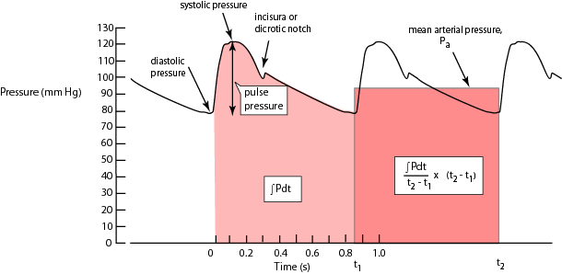

Pulse Pressure
$$ΔP_{pulse}=P_{sys}−P_{dia}$$
$$P_{A}=\frac{\int_{t_{1}}^{t_{2}}{P}dt}{t_{2}−t_{1}}\underset{rule of thumb}{\underbrace{≈}}P_{dia}+\frac{ΔP_{pulse}}{3}$$

Slide 33
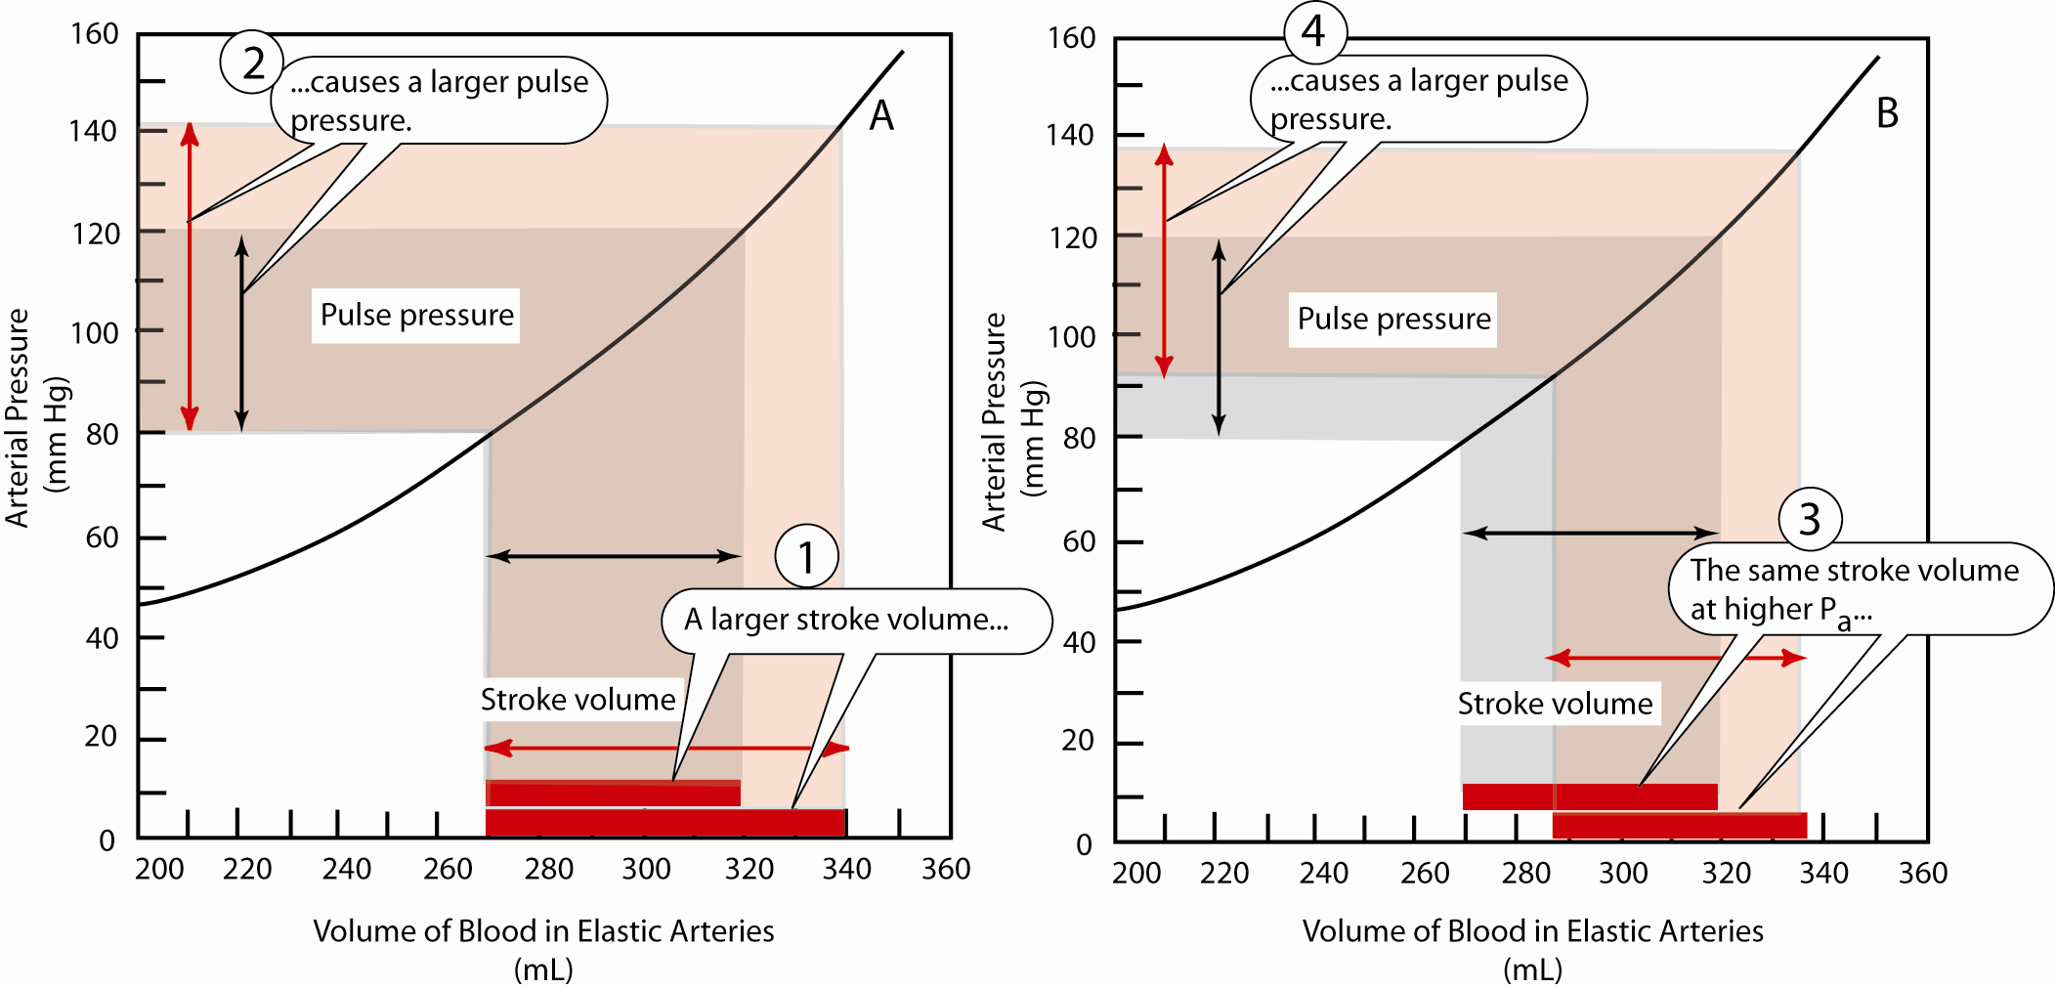
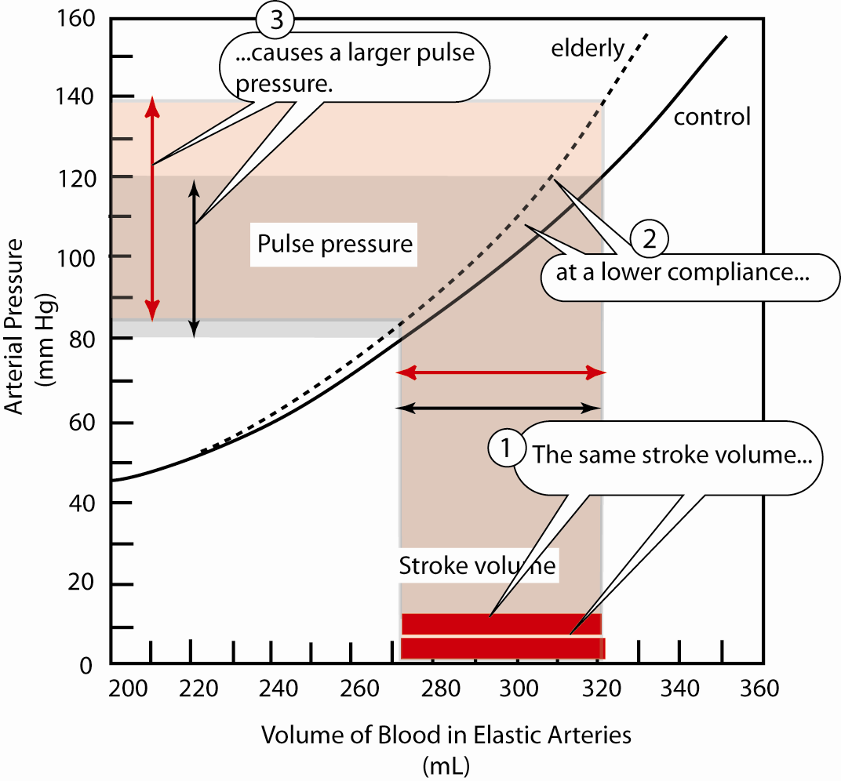
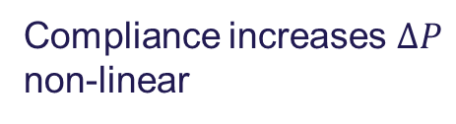
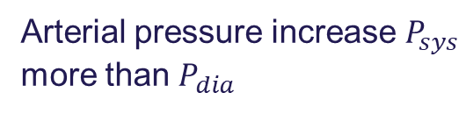

Pulse pressure and stroke volume
Stroke Volume increase $P_{sys}$
Arterial pressure increase $P_{sys}$ more than $P_{dia}$
Compliance increases $ΔP$ non-linear
Notes:
Se X-axen som reference

Slide 34
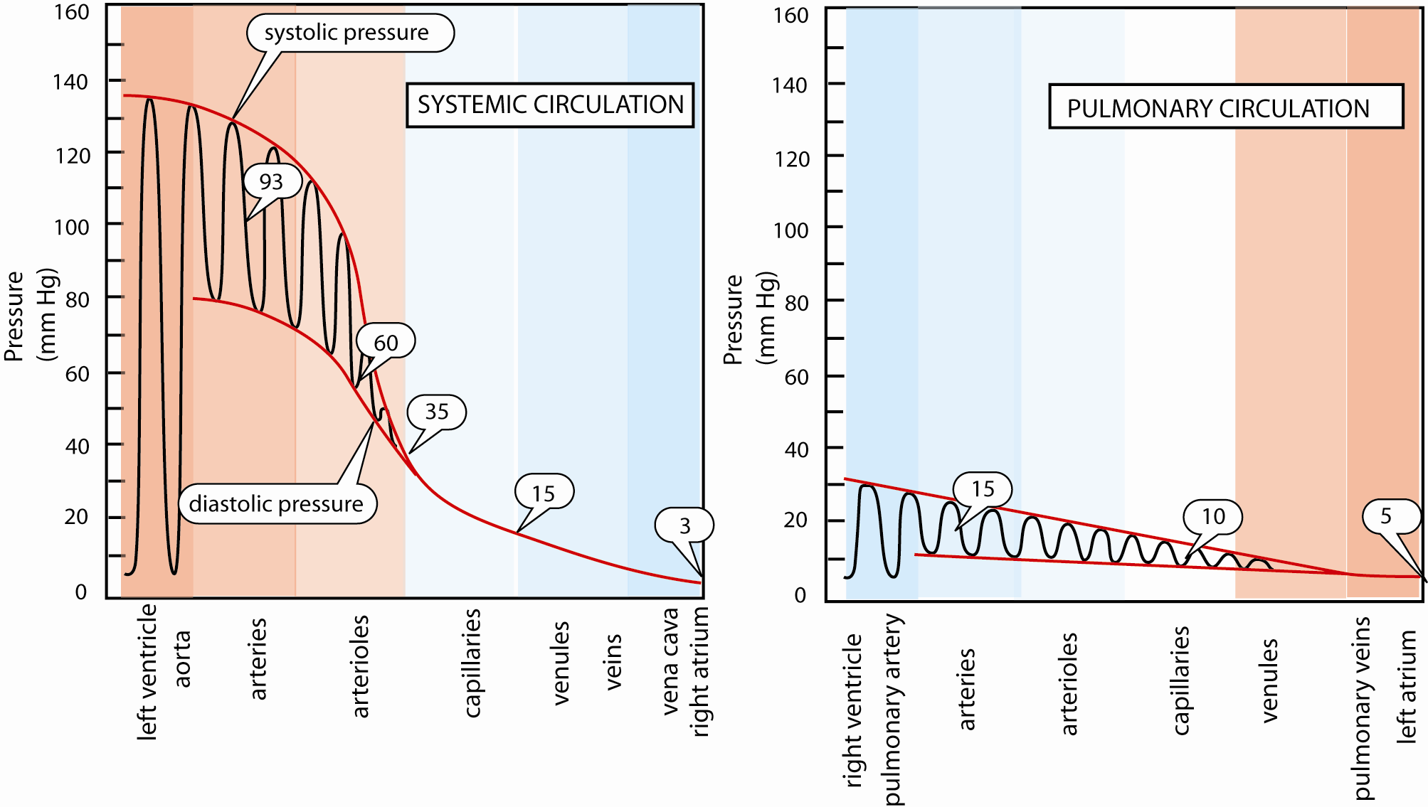
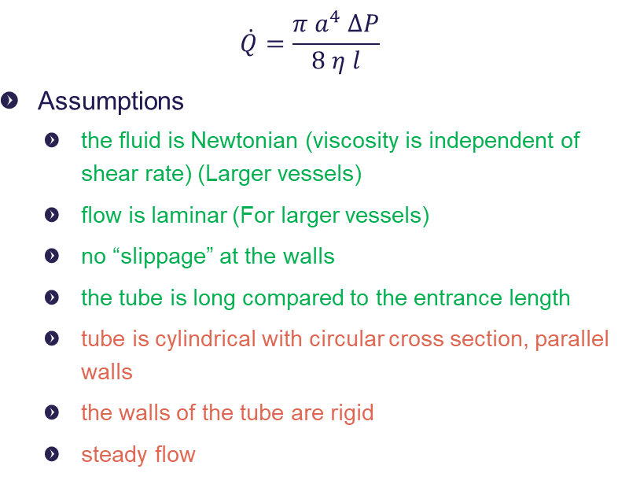
Poiseuille’s Law for approximating flow
$$\dot{Q}=\frac{π a^{4} ΔP}{8 η l}$$
Assumptions
  the fluid is Newtonian (viscosity is independent of shear rate) (Larger vessels)
  flow is laminar (For larger vessels)
  no “slippage” at the walls
  the tube is long compared to the entrance length
  tube is cylindrical with circular cross section, parallel walls
  the walls of the tube are rigid
  steady flow
Notes:
Hvordan udregner man modstanden i et kar?
Hvad har betydning for modstanden?
Hvilket mål har størst effekt?
Hvad sker der for modstanden hvis man mindsker arealet af et kar?

Slide 35
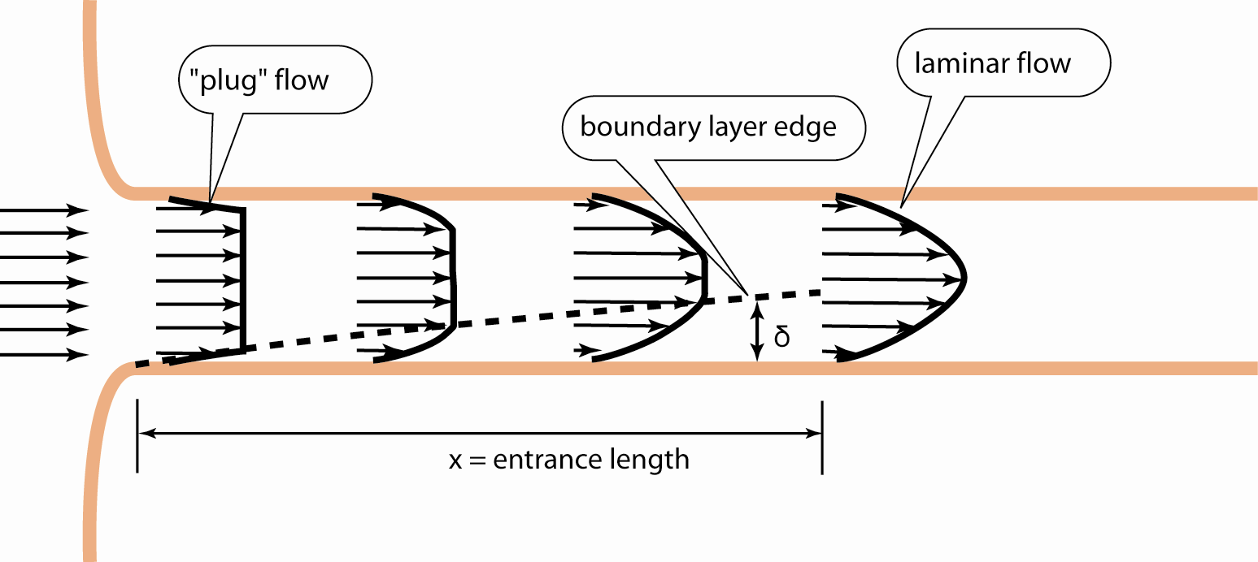

Poiseuille’s Law for approximating flow
Velocity Profile
$v(r)=v_{max}(1−\frac{r^{2}}{a^{2}})$
    r is distance from center of tube
    a is diameter of tube
a
r

